Slide 1

Advertisement Monitoring System Through Live Broadcast
By:
Muhammad Furqan Javed
Hassan Raza Khan Tareen
Supervised By:
Dr. Imran Siddiqui
Bahria University Islamabad Campus

Slide 2

Introduction(contd.)
There are hundreds of videos broadcasted on the daily basis.
And in these broadcast videos there are large number of advertisements are displayed.
Live Broadcasts Revenue worldwide 171bn USD. (expected growth 3% in 2023, Statista)
The advertisers/sponsors pay the TV channels, Live broadcasters for their advertisements based on seconds.
Example: Sports season, Important events of state e.g election season, or cultural event.
Statista: https://www.statista.com/topics/5952/television-advertising-worldwide/

Slide 3

Introduction
Advertisement Monitoring System through Live Broadcasts.
To monitor Live broadcasts and Achieve Broadcasted Video.
Generates Report of Monitored advertisement.
To minimize the challenge, companies and brands are facing in monitoring their advertisements.
To maximize the profit by monitoring the advertisement, so advertisers invest the right amount of money for the time the advertisement is played.

Slide 4
Problem?
Worldwide companies invests billion dollars on advertisements of their product/service.
Monitoring is mostly through human operators.
Challenging to identify that their advertisement is broadcasted as the money charged.

Slide 5
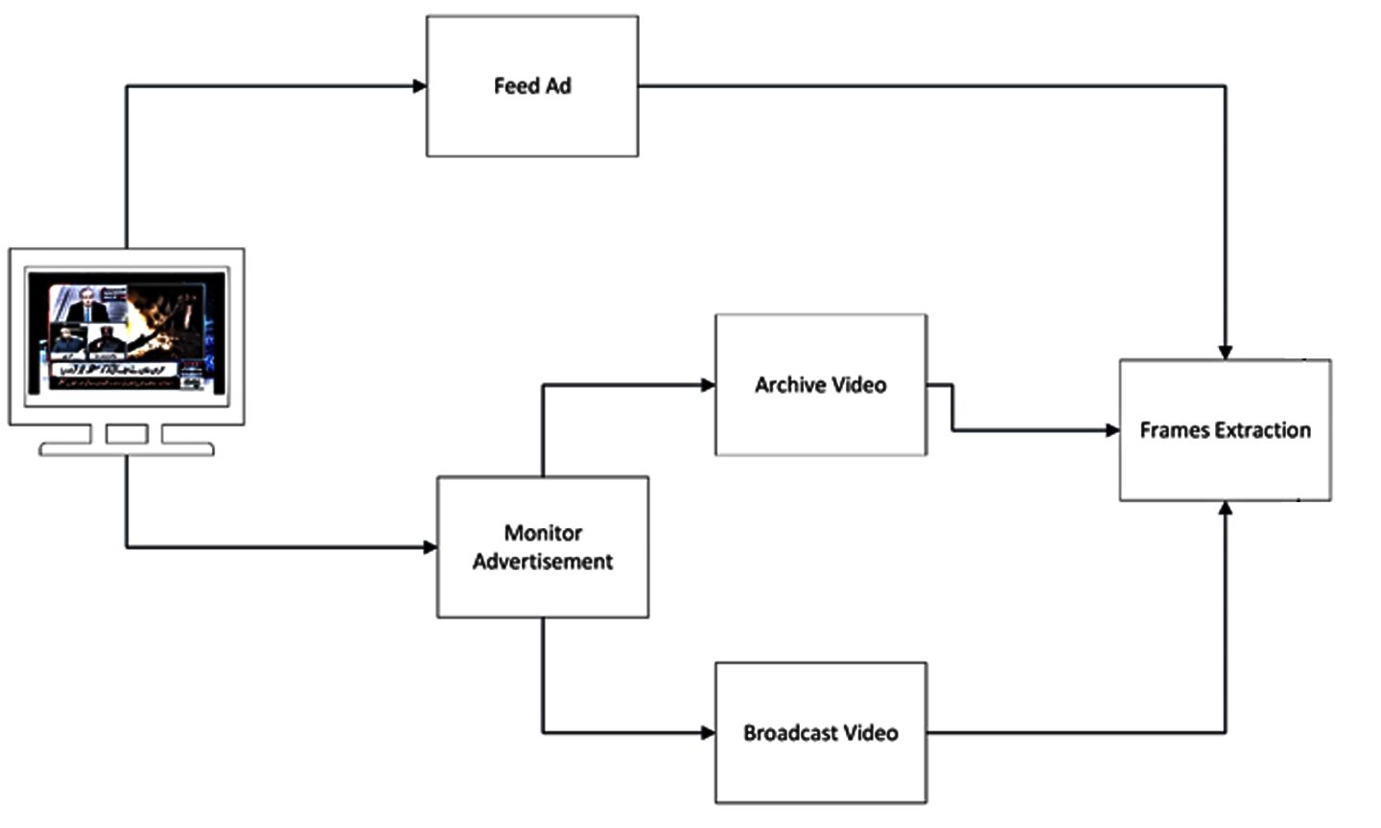
Methodology(contd.)

Slide 6
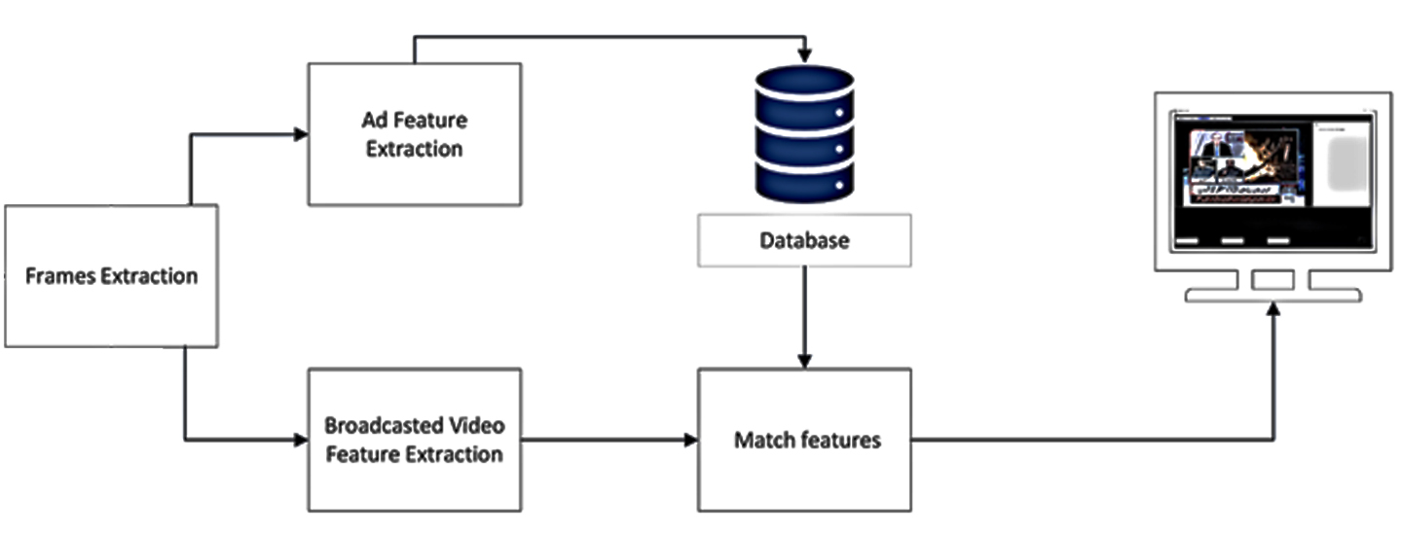
Methodology(contd.)

Slide 7
Methodology(contd.): Feature Extraction
Feature extraction is based on CNN Model VGG16.
VGG16 Convolutional Base with extra one dense with ‘relu’ function and one maxpooling layer is used to features extraction.
4096 unit of features will be extracted for each frame.

Slide 8
Methodology(contd.): Feed Advertisement
Choose advertisement which you want to monitor.
Frames of chosen advertisement will be extracted and saved in local storage.
The frames will be passed to base model(feature extractor).
Feature extractor will extract frames and save .npy file of features firebase(database) of application.

Slide 9
Methodology(contd.): Monitor Advertisement
Live Broadcast
Archive Video (Broadcasted)

Slide 10
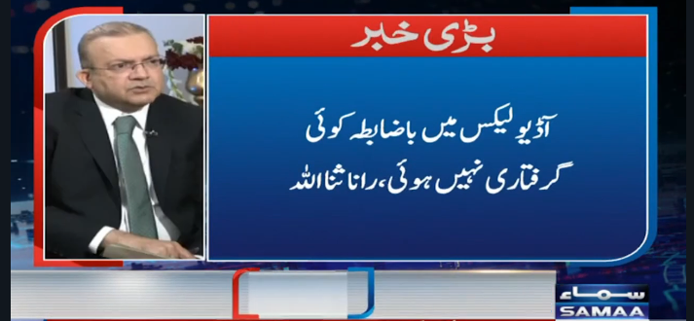

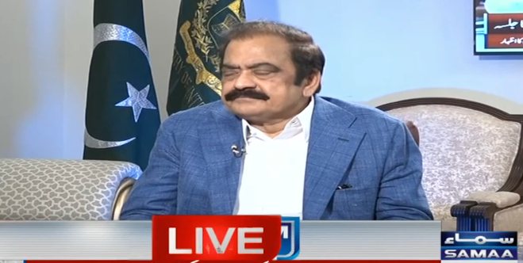



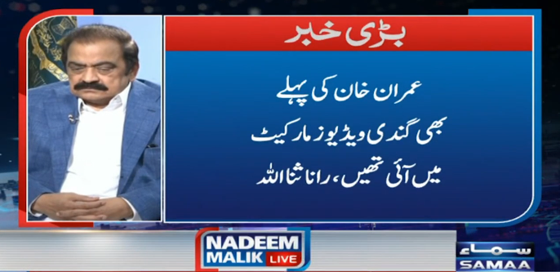
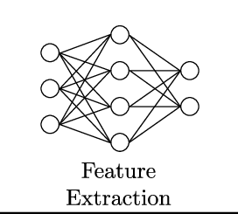





Monitor Advertisement(contd.)
Not Matched
Repeat Process for next frame
Matching Features
Save time & Duration in report
Matched
Features
Selected Ad.
Features

Slide 11
Monitor Advertisement(contd.)
Live Broadcast
Execute live broadcasts from selected source.
Extract frame of broadcast on each second and pass it to feature extractor.
Feature extractor will pass these features to match function.
Where the extracted features of live broadcast matched with selected advertisement features.
Function will return the Boolean result.
The time and duration of matched features will be saved in report.

Slide 12
Monitor Advertisement
Archive Video
Load the archive selected video in frame extractor.
Passes the frames in feature extractor, which will extract features.
Feature extractor will pass these features to match function.
Match function will match the archive video features with the selected advertisement features.
The video time where the features get match will be returned in report.

Slide 13

Dataset
Video Based Dataset.
15 advertisements are fed for test purpose.
More can be done.
Live Broadcasts and Broadcasted Videos are also used as test.

Slide 14
Tests Confusion matrix
Actual
 | Advertisement | No Advertisement
Advertisement | 129 | 17
No Advertisement | 15 | 625
Predictions
Accuracy = 0.959
Recall = 0.883
Precision = 0.895

Slide 15
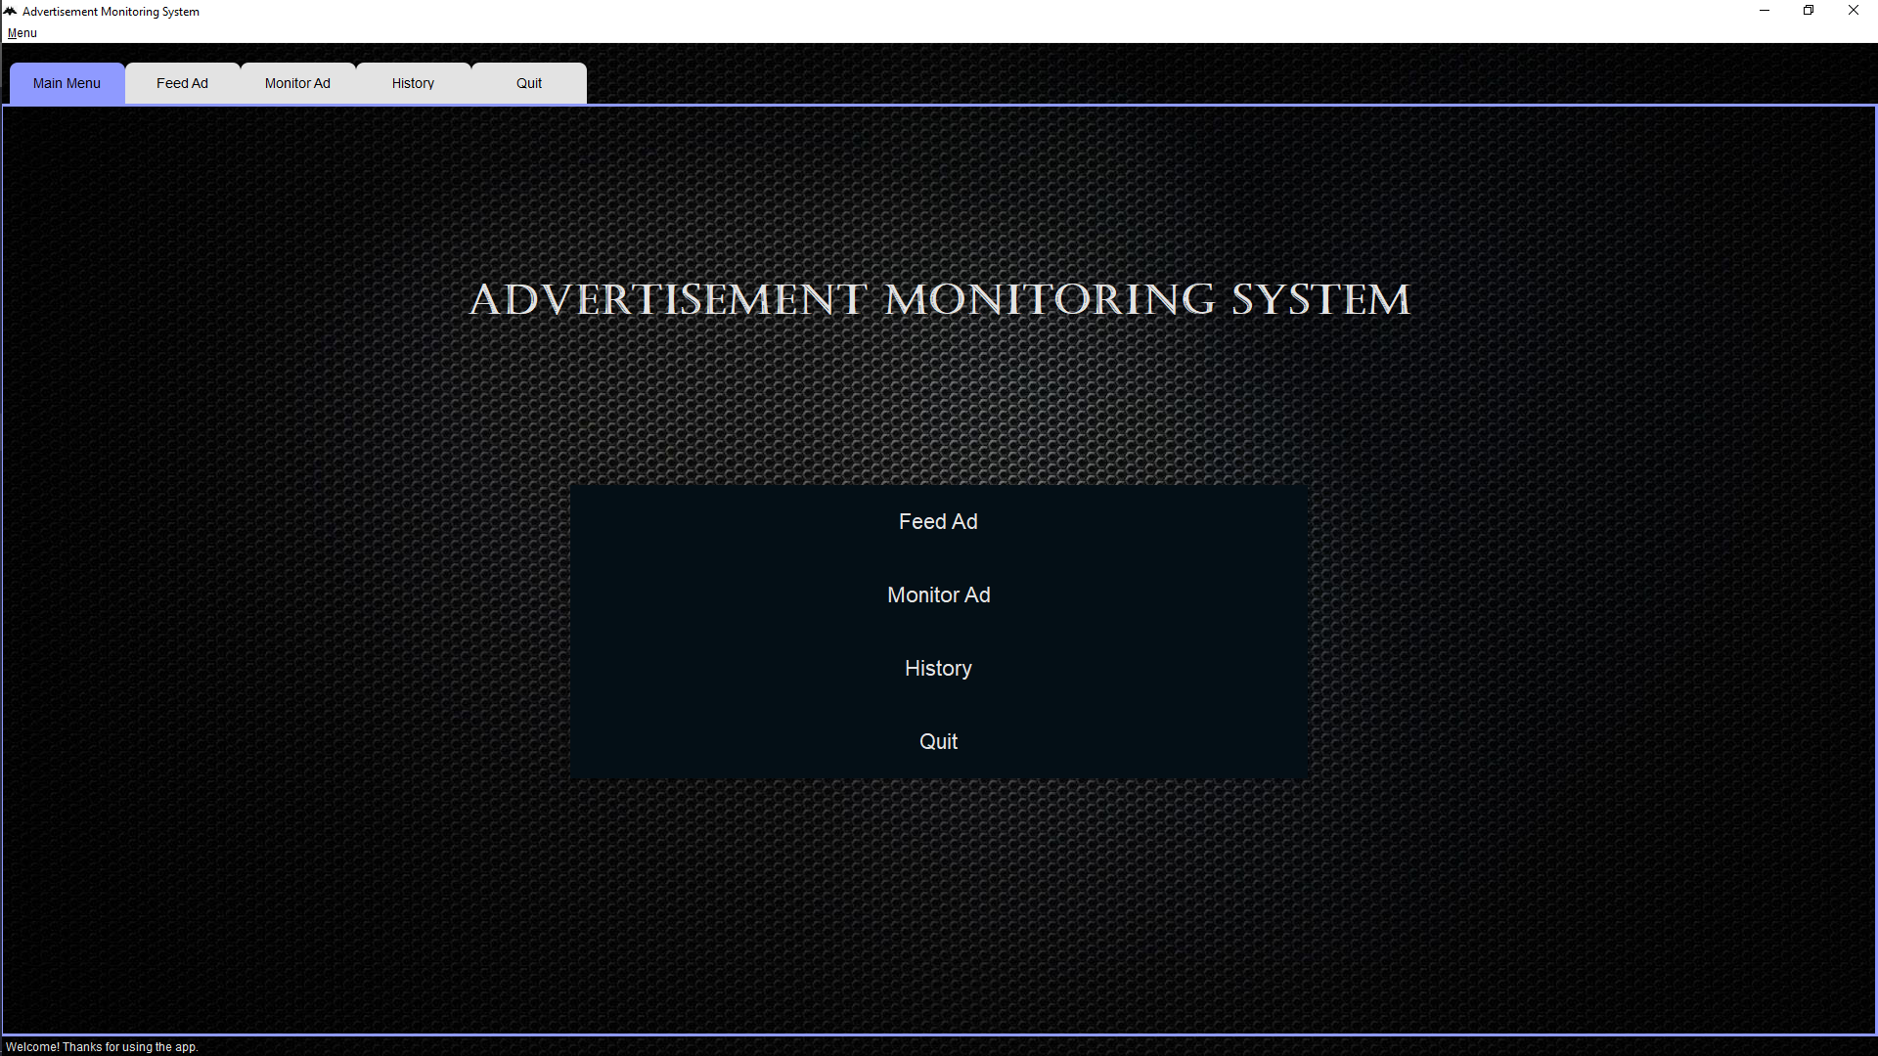
Interface

Slide 16
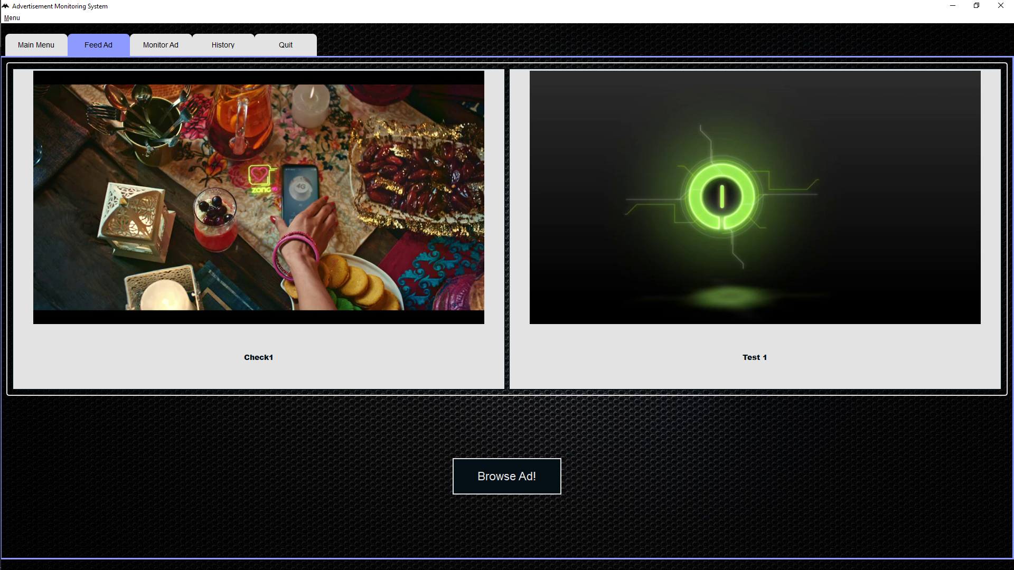
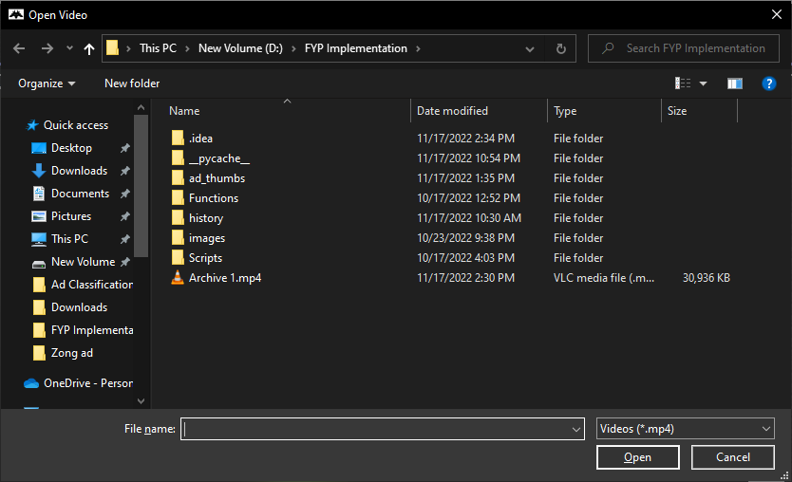
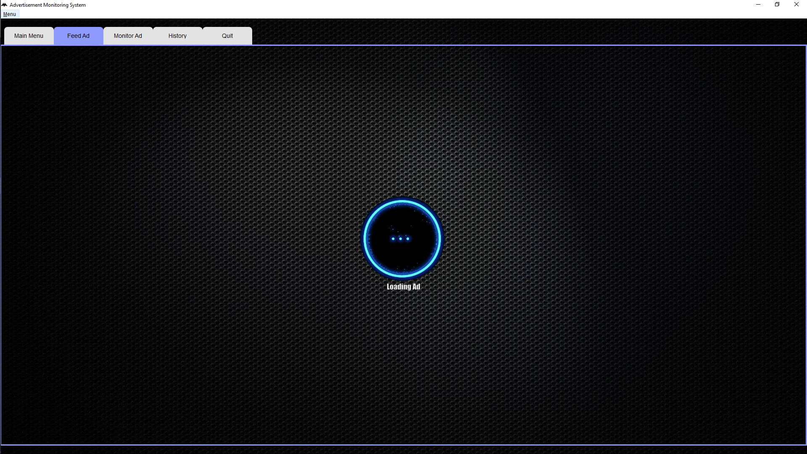
Interface

Slide 17
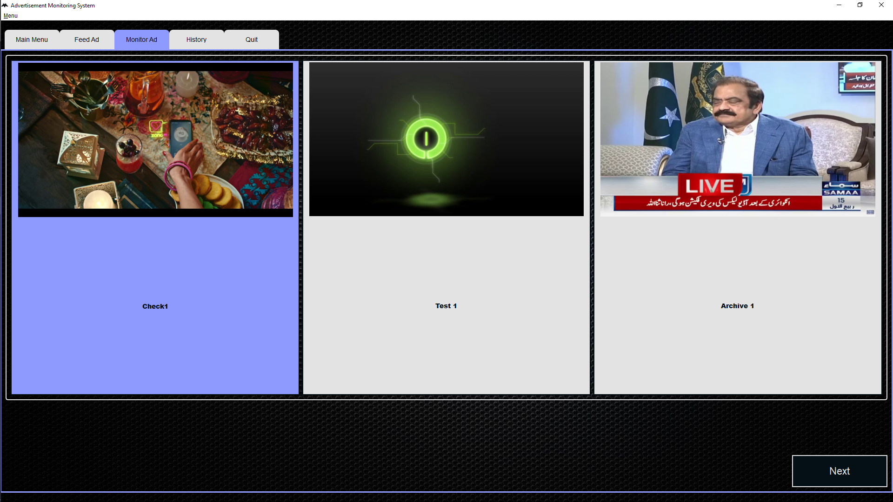
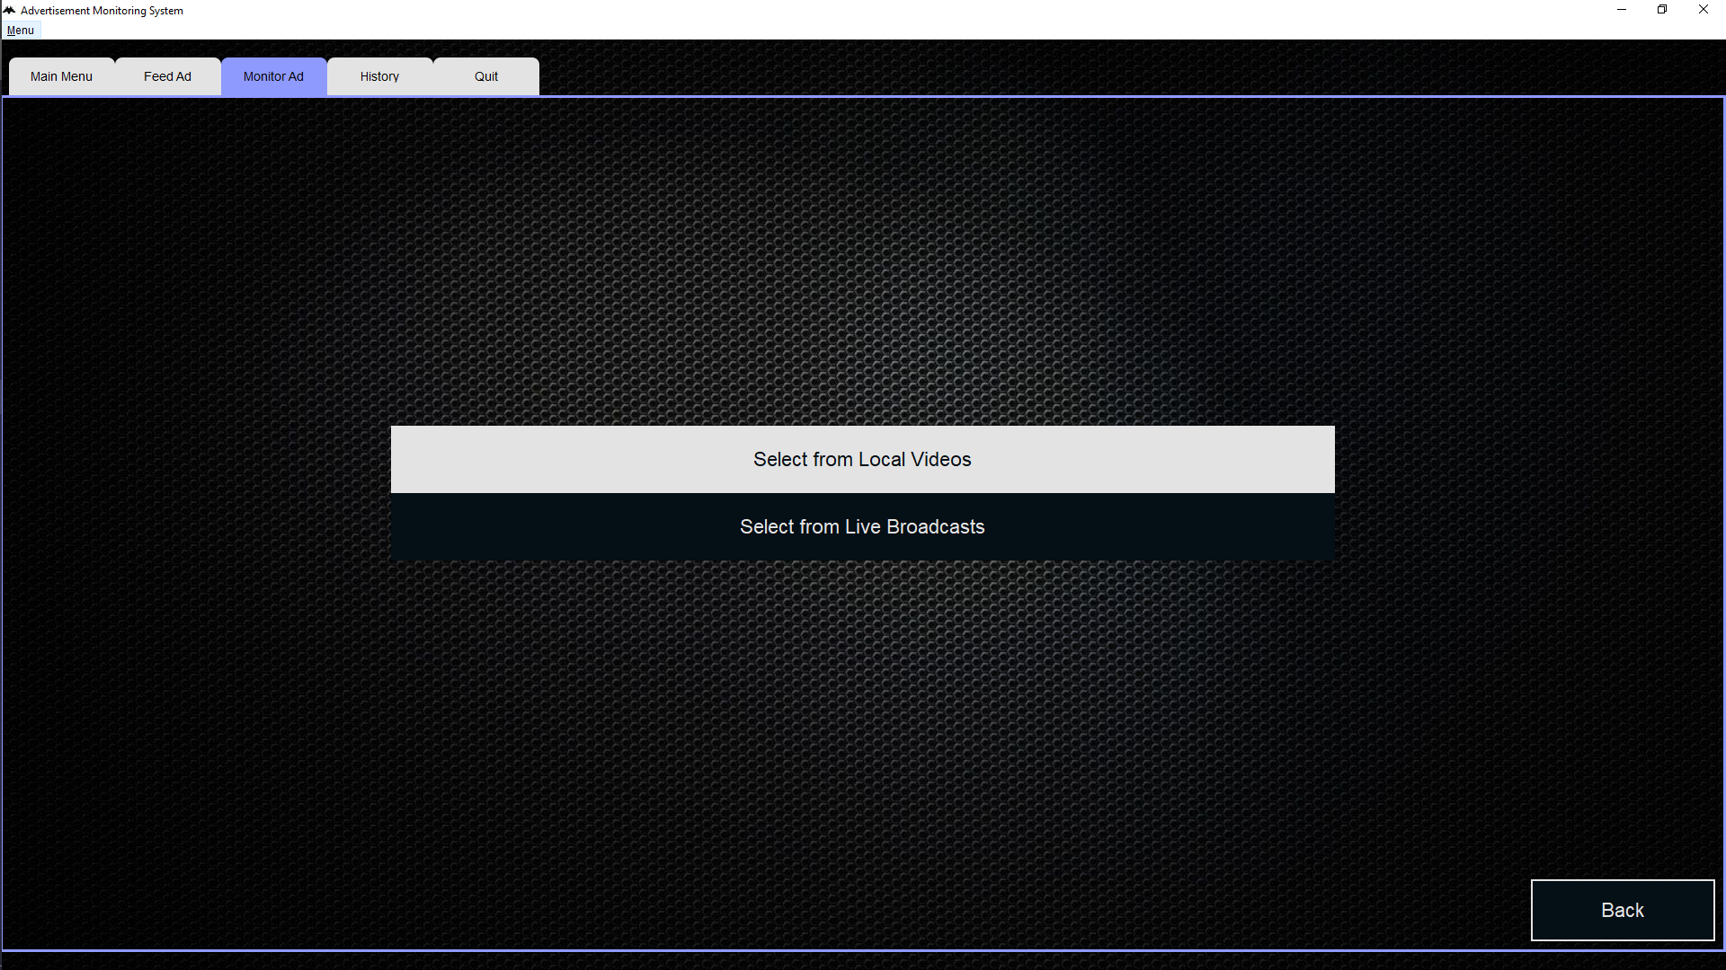
Interface

Slide 18
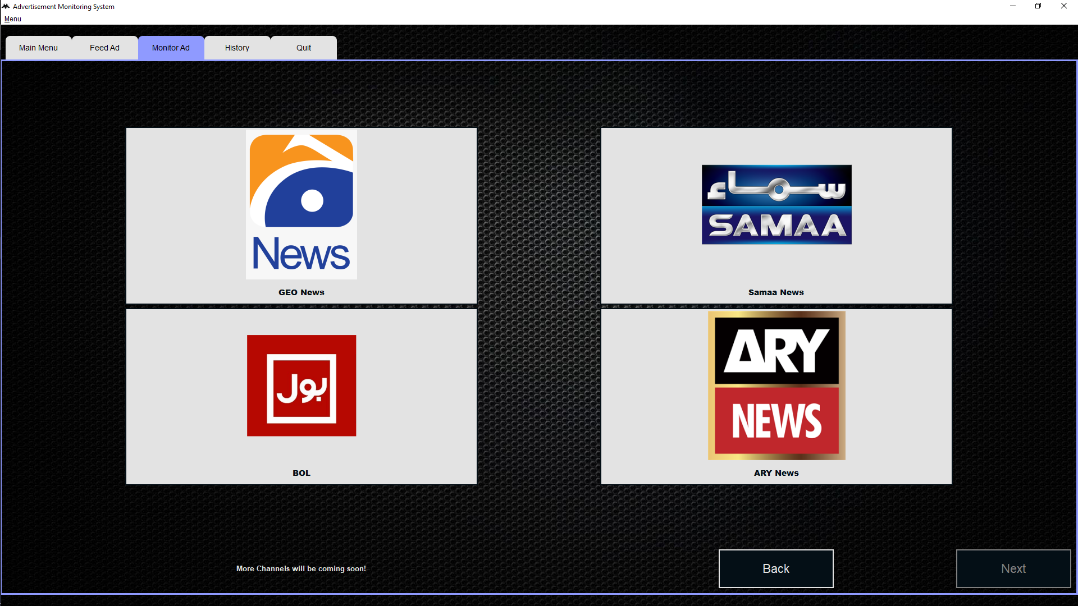
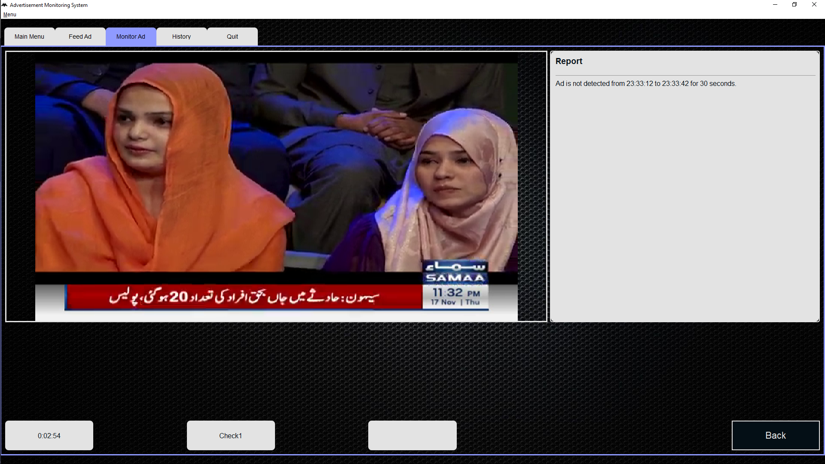
Interface

Slide 19
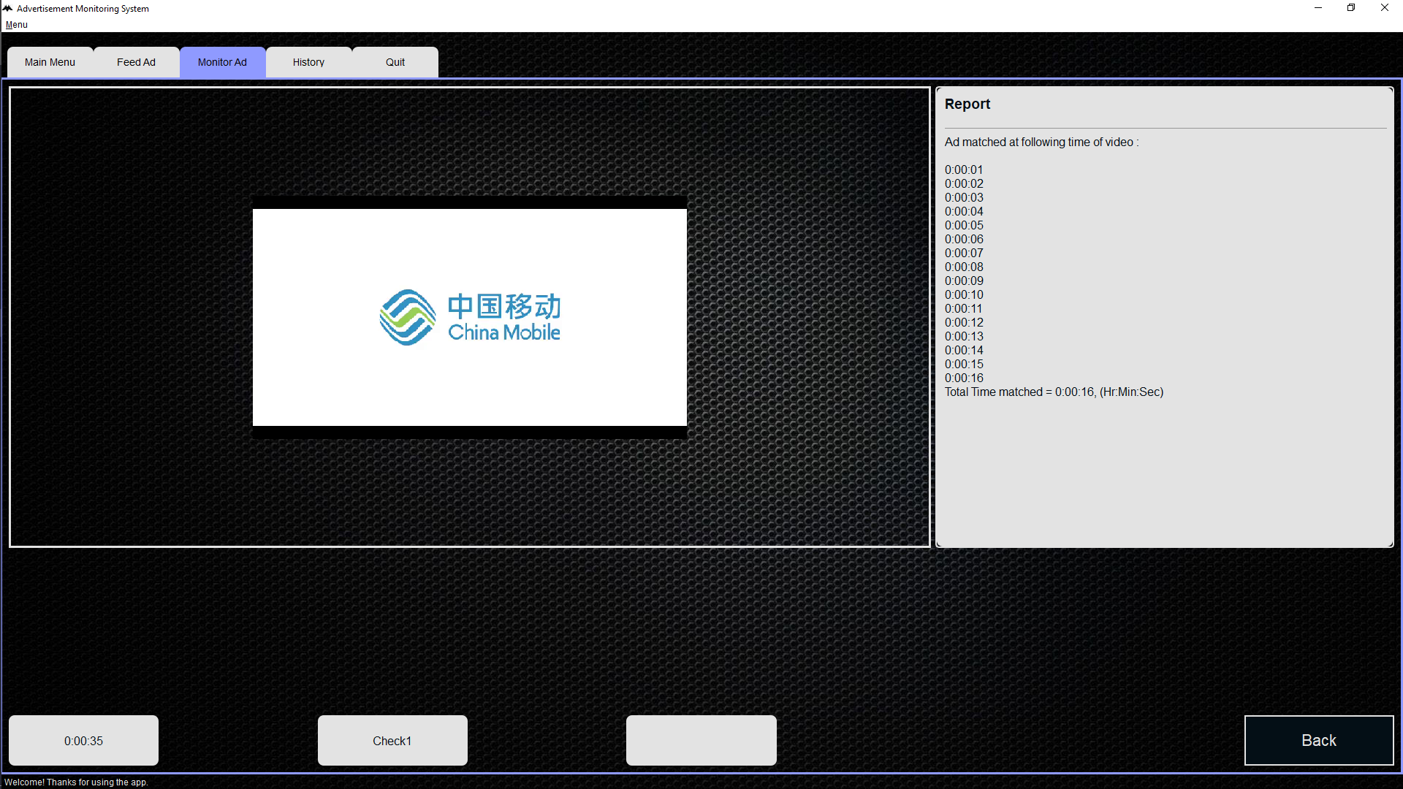
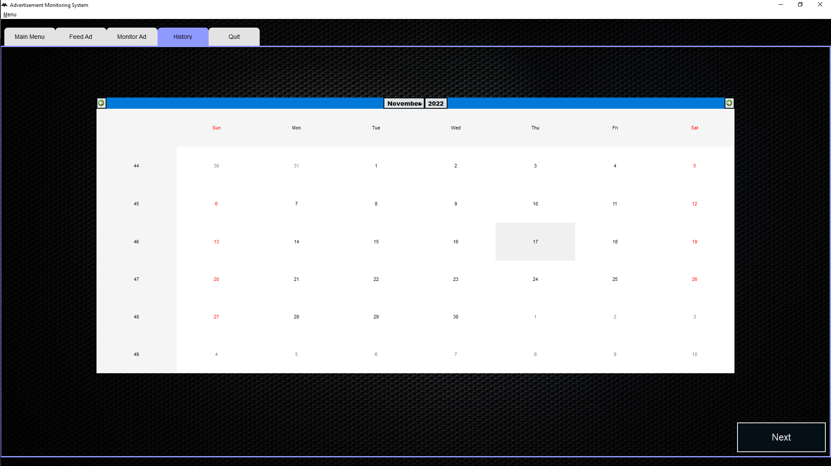
Interface

Slide 20
Conclusion
As news channels are the most vital source to advertise a brand but somehow the advertisement of the clients is not displayed.
Our goal is to help clients in monitoring their advertisements.
And keep record of their payments and broadcasted advertisements.
Future goals

Slide 21
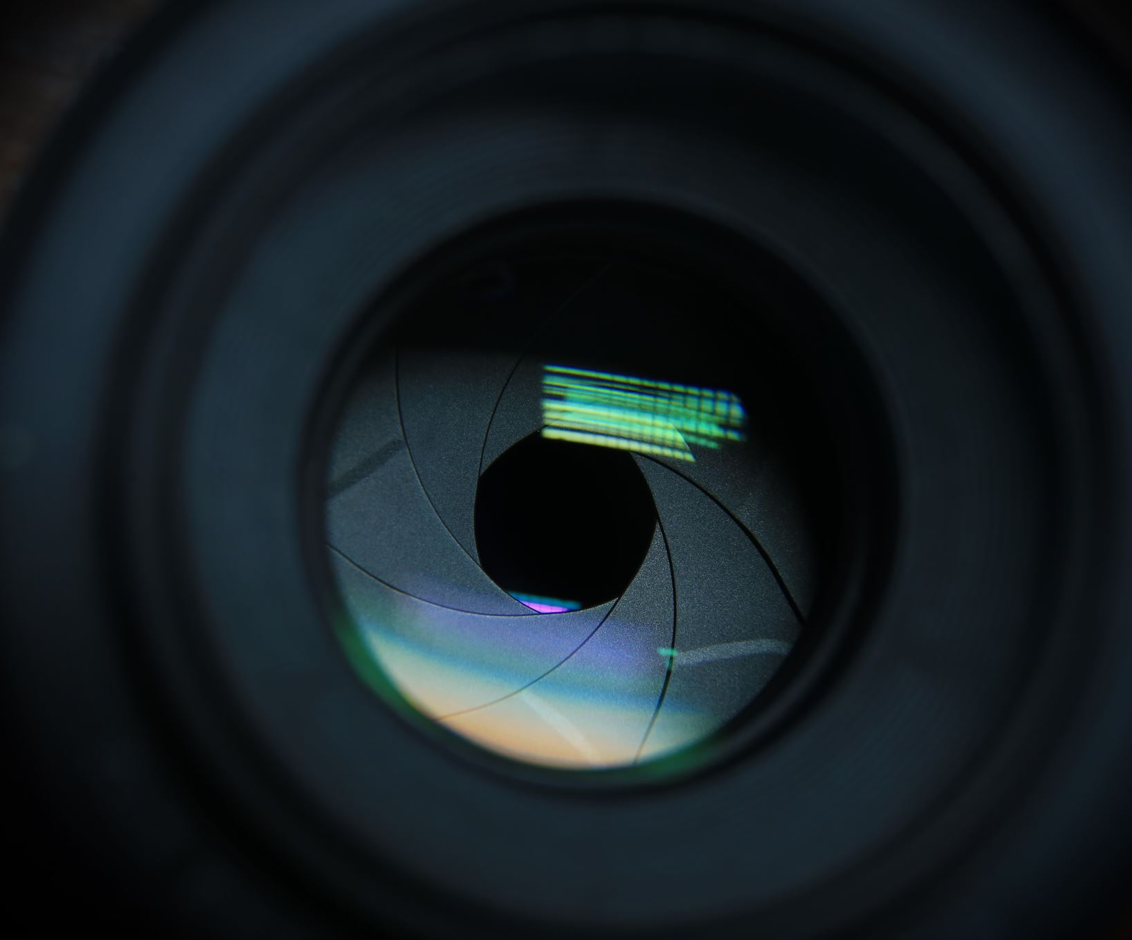
Demo

Slide 22

Thank you

